Slide 1

Pokémon 3 Return of the Kingler 100,000 Teams vs the Elite Four
LT Corinne Desroches
LT Hayden Burger
LT David Lee

Slide 2
Pokémon: game franchise where players battle with teams of fantasy creatures
Complex rock-paper-scissors-etc style elemental types give advantage and disadvantage
Speed, attack, defense, type advantage, hit points, status effects, move sets, etc. for each Pokémon
Teams of up to six
Elements of strategy show up via team order, team type, team stat composition, and multi-team strategies
Elements of luck from the battle equation which involves RNG for damage and critical hit calculations
The Elite Four are one of the final challenges for a player
A sequence of four teams to beat and become the Pokémon Champion
When we last left our heroes…
Teams of 6 could go up against the Elite Four, but the computations took hours for just 11 teams
Results
Hamming
Recap
Experiments
Assumptions
API

Slide 3


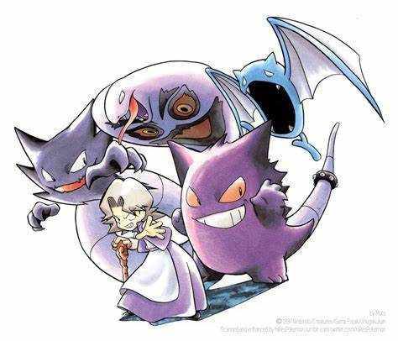
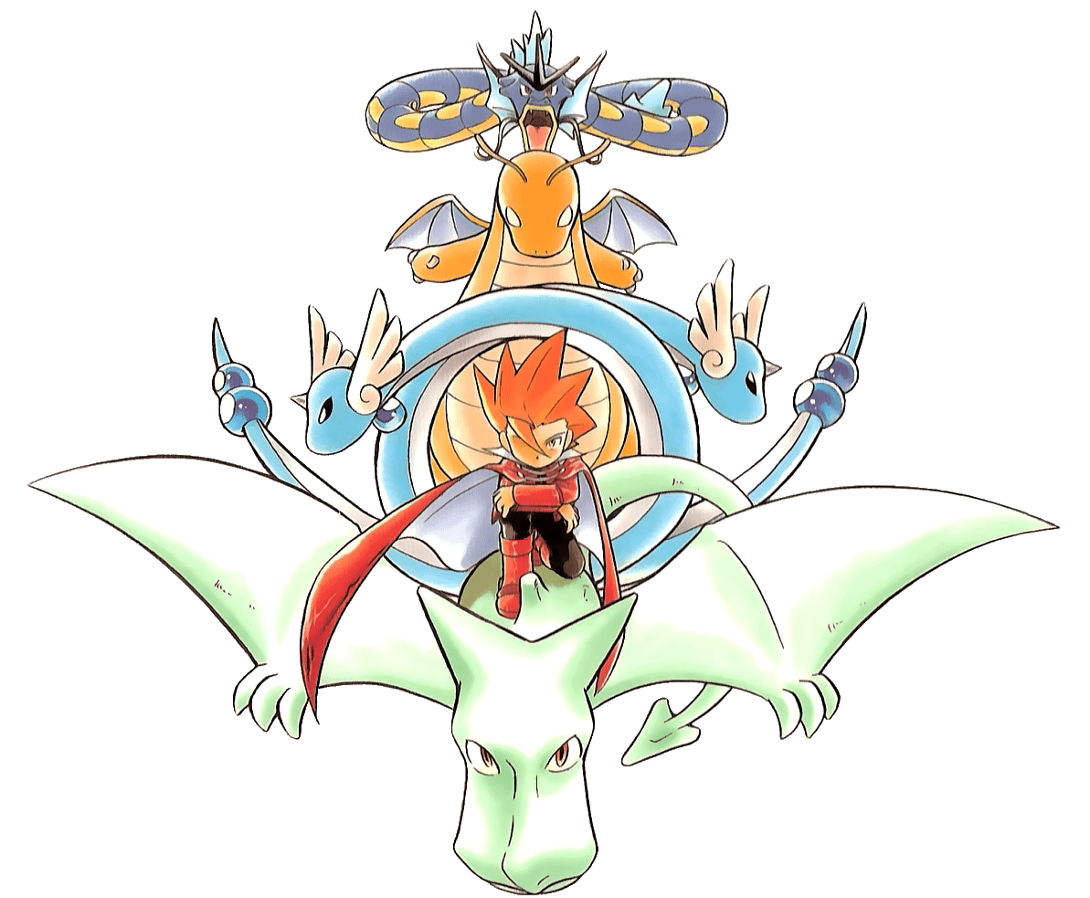
Elite Four Composition
Lorelei (Water/Ice type)
Dewgong, Cloyster, Slowbro, Jynx, Lapras
Bruno (Rock/Fighting type)
Onix, Hitmonlee, Hitmonchan, Onix, Machamp
Agatha (Poison/Ghost type)
Gengar, Golbat, Haunter, Arbok, Gengar
Lance (Dragon type)
Gyarados, Dragonair, Dragonair, Aerodactyl, Dragonite
Results
Hamming
Recap
Experiments
Assumptions
API

Slide 4
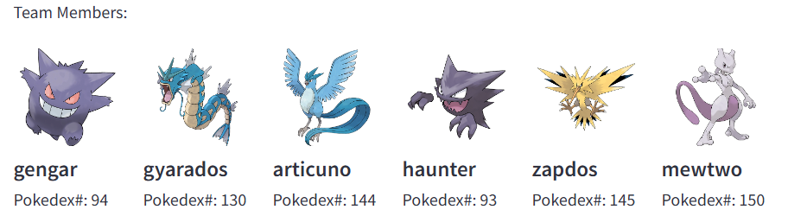
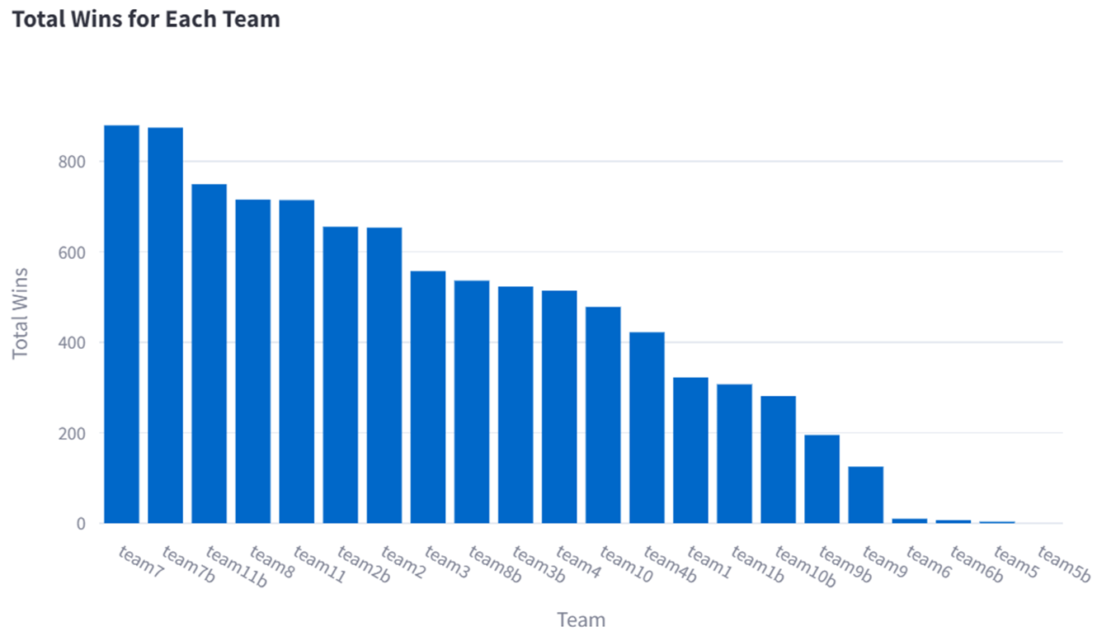
Results
Hamming
Recap
Experiments
Assumptions
API
Previous best team of the 11 hand-picked teams
87.9% win rate over 1000 battles
Highest individual win rates

Slide 5
Problem statement
Is there a random team that could do better than our 11 hand-selected teams from last quarter?
Upgrades to the model
Can we use an API instead of the CSVs?
Can the Hamming test 11,853,911,588,401 teams? (~12 trillion)
Can we create a Streamlit app with the expected gigabytes of battle data?
Measure of team performance
The team must survive the gauntlet of all four teams sequentially (20 total opposing Pokémon)
Measure of project performance
Number of teams simulated
Observations that lead to actionable decisions
Results
Hamming
Recap
Experiments
Assumptions
API

Slide 6
Only Pokémon from Generation 1
All Pokémon now at Level 50
Base stats used (ignored IV and EV values)
Moves are randomly picked from all available moves for each Pokémon (to reduce modeler bias)
Full video game battle/damage equation is modeled
PP (move use limits) are ignored, no switching, no items
Full health reset between the Elite’s teams
Sourced data includes the stats for each Pokémon, equations from the video games, and Generation 1 Elite Four composition
Testing all 11,853,911,588,401 team combinations repeatedly is still computationally expensive
But maybe Hamming can get us there in parallel
Experiment of 100 attempts per random team against the full gauntlet of the Elite Four to reduce the computational effort from the 1,000 replications of projects past
Results
Hamming
Recap
Experiments
API
Assumptions

Slide 7

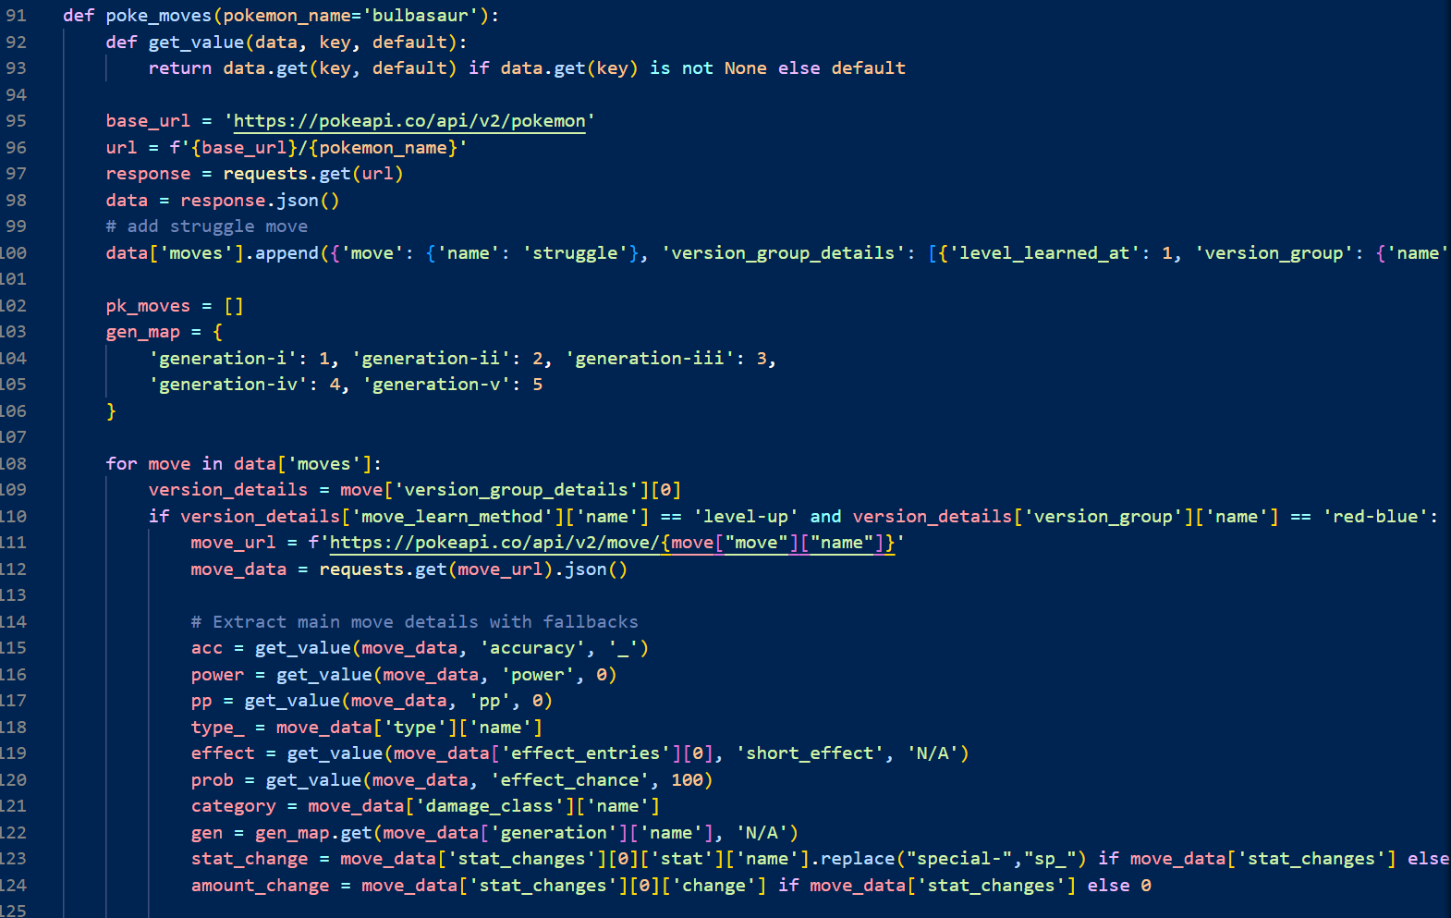
All the data and equations are available readily on sites like Bulbapedia and Serebii, with the collected data files on Kaggle
This data was folded into our original models to govern the behavior of every entity and their attacks and interactions
Now Introducing:
Results
Hamming
Background
Experiments
Assumptions
API

Slide 8
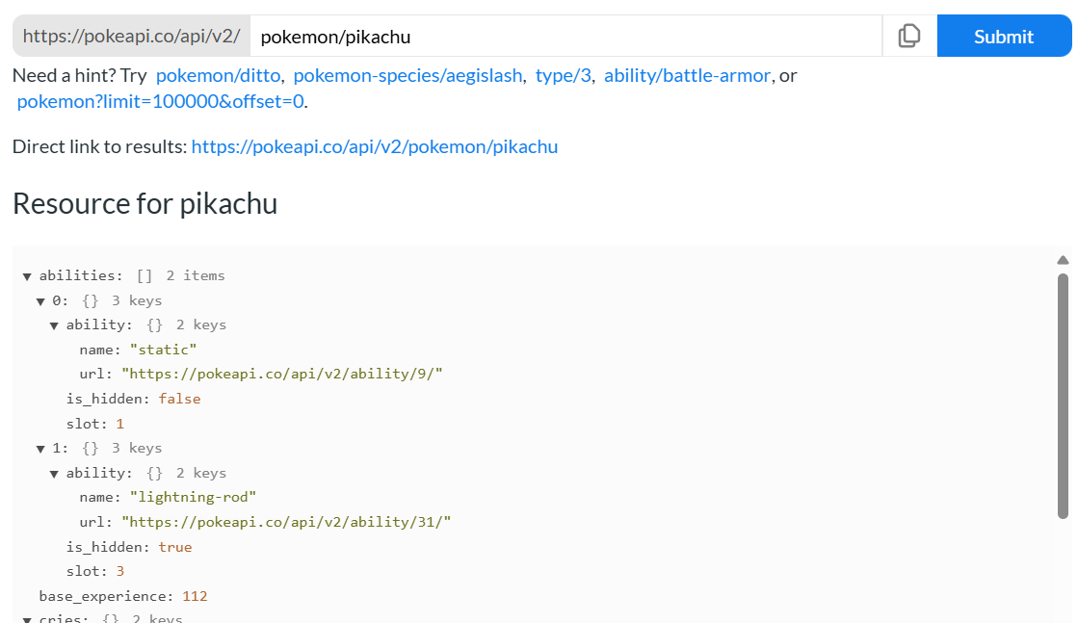
Results
Hamming
Background
Experiments
Assumptions
API
User Friendly Learning Environment
Accurate Data for Each Generation
JSON output

Slide 9
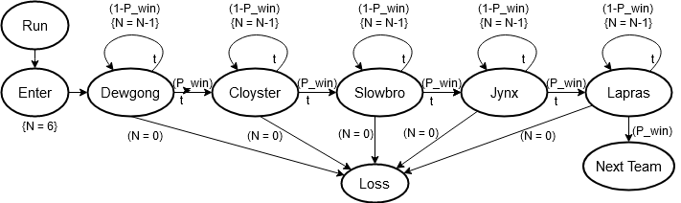
Previously:
Created a module with a custom Pokémon class
Tracks states and enables battle engagements between individual enemies
Ran every Pokémon against every Pokémon in a Monte Carlo simulation
Adjusted the model to create framework for queue-type team battle system
Relay-style 1v1 engagements until all Pokémon in a single team have lost
Expanded to run a player team against four enemy teams called “Elite Four”
Results
Hamming
Background
Experiments
Assumptions
API

Slide 10
Previously:
Aimed to identify player team that most “efficiently” could defeat the Elite Four (most wins, fewest turns)
However:
Only 11 teams were tested
Results
Hamming
Background
Experiments
Assumptions
API

Slide 11
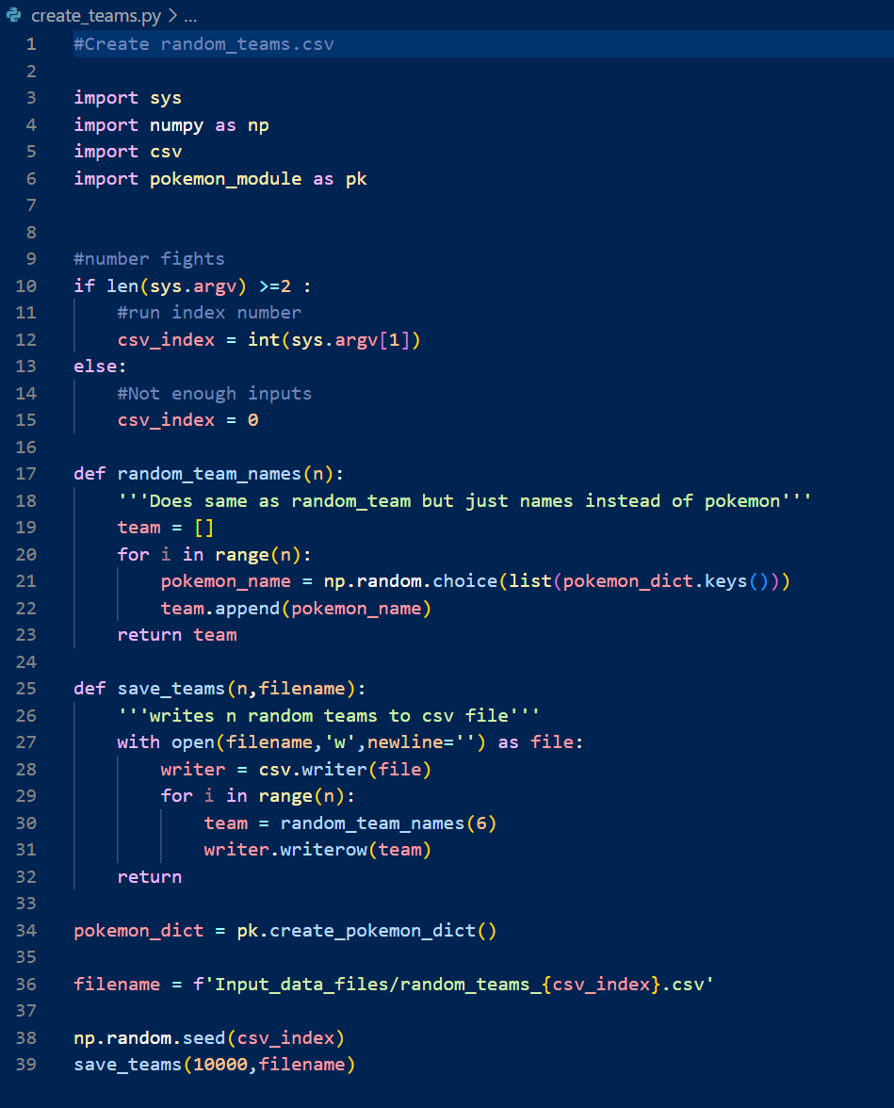
Now…
Created 100 CSVs to hold 10 million random team compositions
Produced in batch on Hamming
--array=0-99
Results
Hamming
Background
Experiments
Assumptions
API

Slide 12
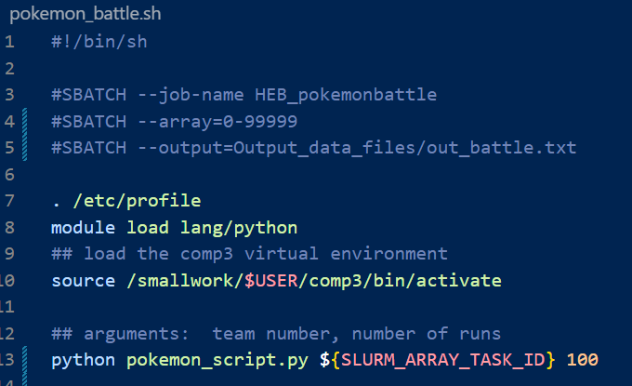
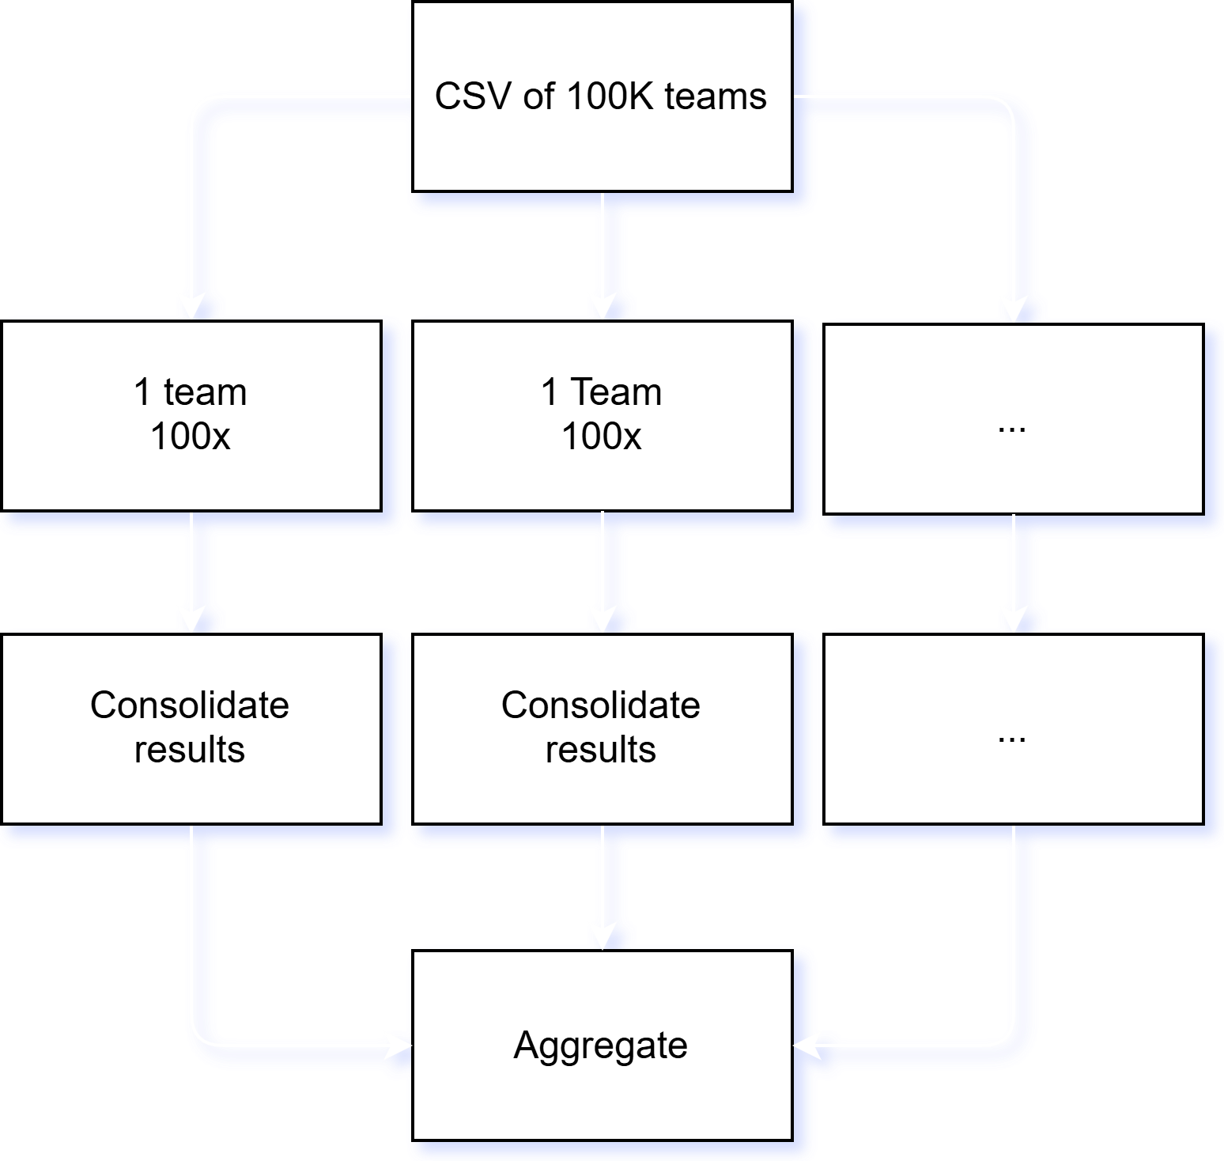
One team at a time, 100 runs each
Recombine afterwards
Results
Hamming
Background
Experiments
Assumptions
API

Slide 13
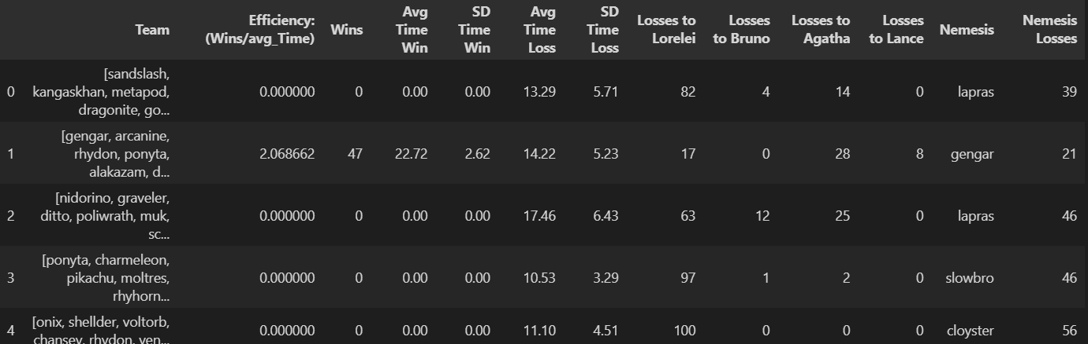
Batch used to call recombining python code
Loop through glob paths
Append to dataframe
Save to CSV
100,000 team CSV used to keep track of the output statistics
Results
Hamming
Background
Experiments
Assumptions
API

Slide 14
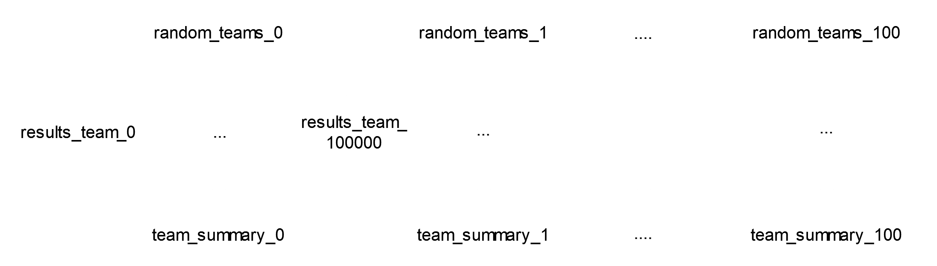
100 CSVs -> 10 million CSVs -> 100 CSVs
Results
Hamming
Background
Experiments
Assumptions
API

Slide 15
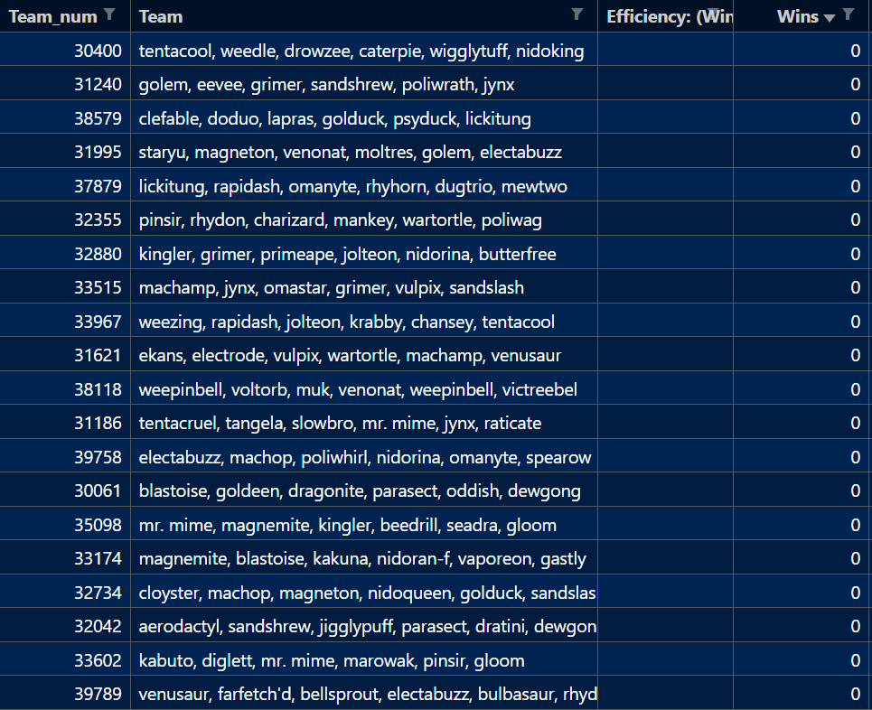
Thousands upon thousands of teams with no chance at all
Results
Hamming
Background
Experiments
Assumptions
API

Slide 16
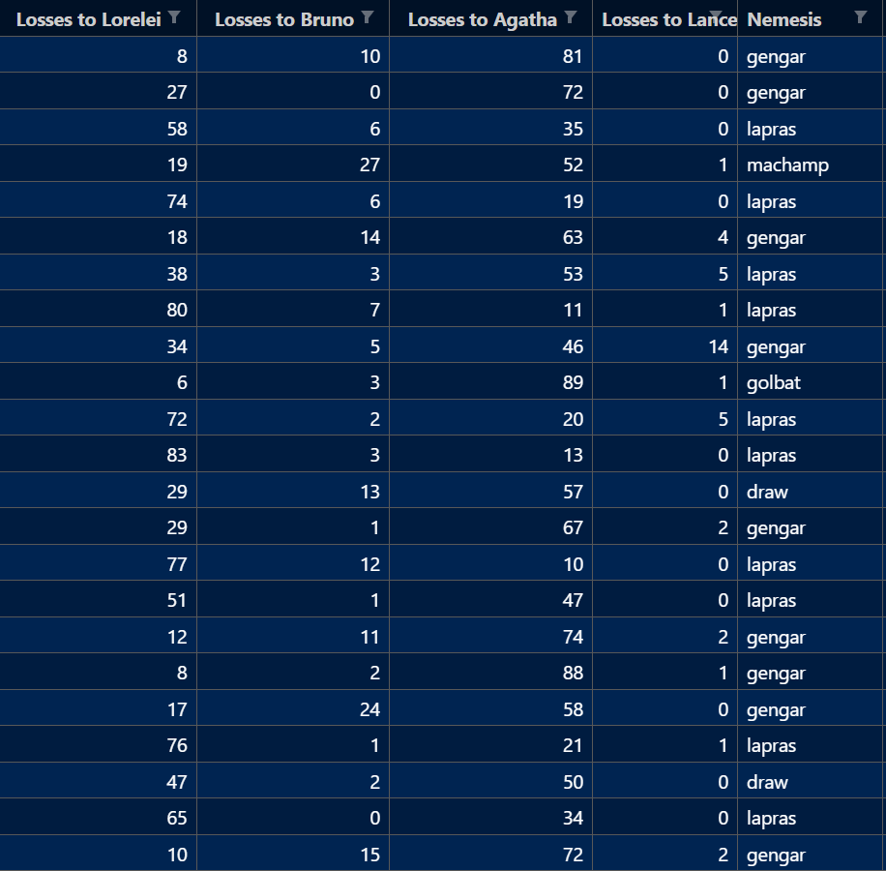
A majority of them falling to Agatha, the third of the Elite Four
Agatha has two Gengars
Results
Hamming
Background
Experiments
Assumptions
API

Slide 17
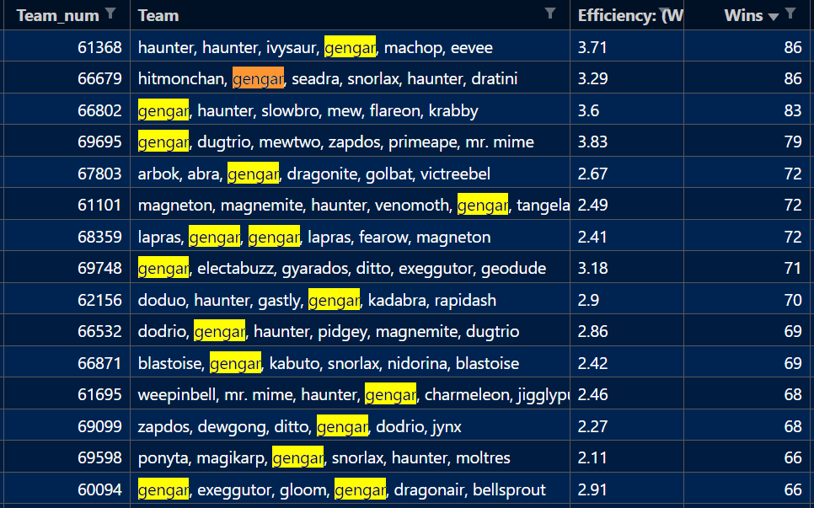
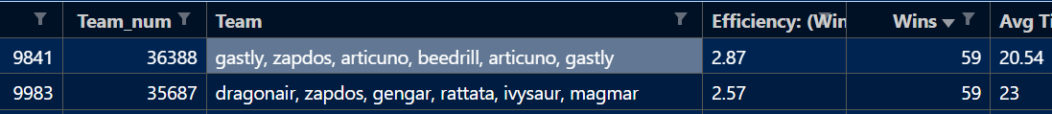
Every single team so far with a win percentage more than 60% has at least one Gengar on the team
Results
Hamming
Background
Experiments
Assumptions
API
The most successful team without Gengar only achieved a 59% win rate

Slide 18

Results
Hamming
Background
Experiments
Assumptions
API
Artist credit: starart_ia

Slide 19
Why Gengar?
Confuse Ray causes the target to become confused. Confused Pokémon have a 33% chance of hurting themselves each turn, for 1-4 attacking turns (50% chance in Generations 1-6).
Lick deals damage and has a 30% chance of paralyzing the target
Night Shade’s damage is equal to the user's level. So at level 50, the Pokémon will inflict 50 HP damage.
Hypnosis puts the target to sleep for 1-3 turns, if it hits. Sleeping Pokémon cannot move (with some exceptions).
Dream Eater deals damage only on sleeping foes and the user will recover 50% of the HP drained.
Results
Hamming
Background
Experiments
Assumptions
API

Slide 20
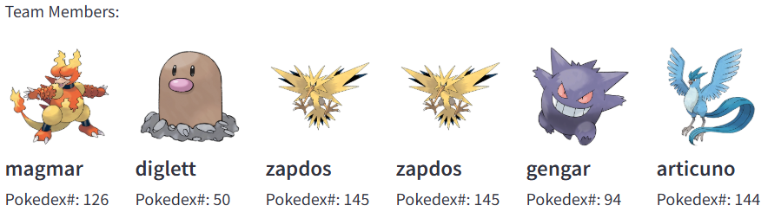
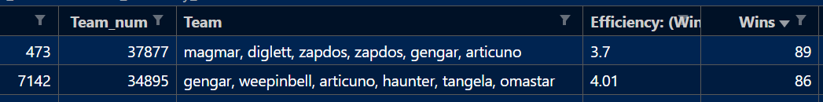
Previous best team
87.9% win rate over 1000 battles
Efficiency of 4.2 (Wins/average time)
Highest individual win rates
Streamlit
Results
Hamming
Background
Experiments
Assumptions
API
New “best” team
89% win rate over 100 battles

Slide 21





Conclusion:
Invest in Gengar but also, start with your intuition
Streamlit
Results
Mechanics
Background
Experiments
Assumptions
Data

Slide 22

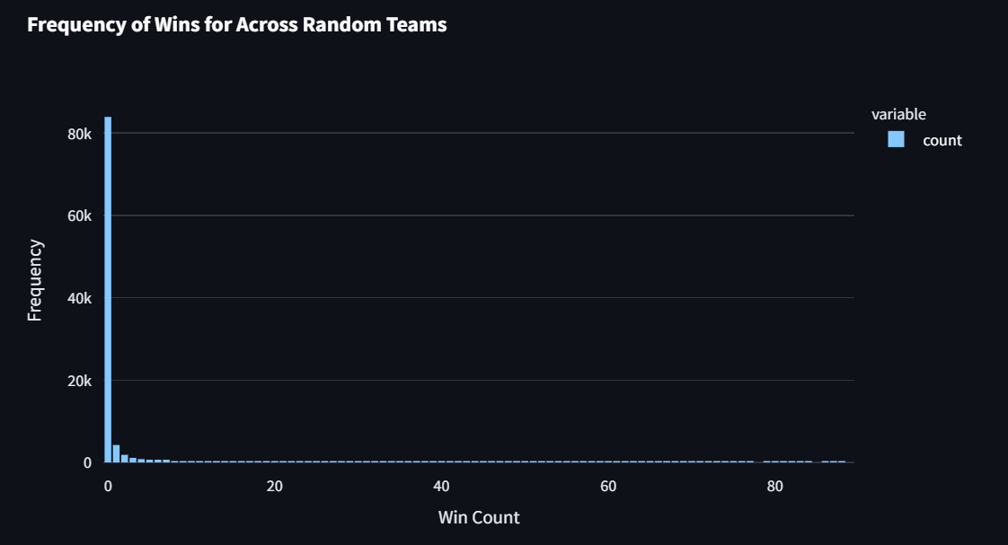
Pokemon 3 Streamlit
Results
Hamming
Background
Questions
Streamlit
Experiments
Assumptions
API

Slide 23
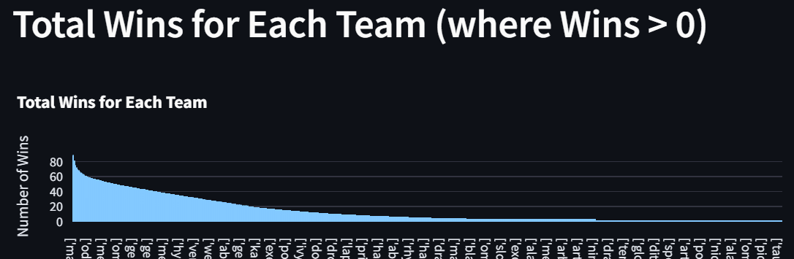
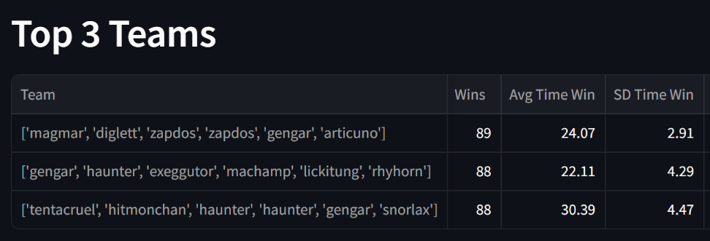
Results
Hamming
Background
Questions
Streamlit
Experiments
Assumptions
API

Slide 24
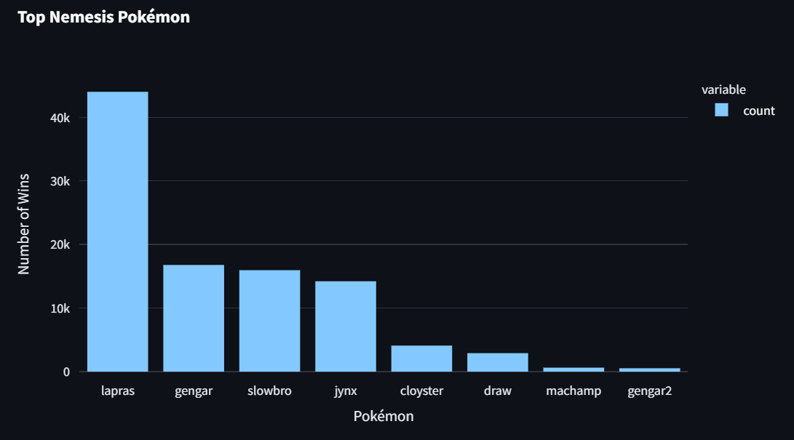
Results
Hamming
Background
Questions
Streamlit
Experiments
Assumptions
API

Slide 25
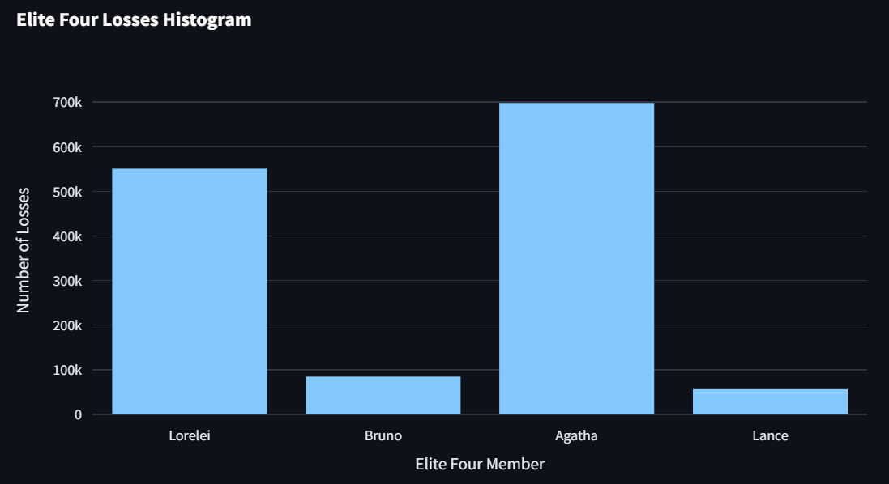
Results
Hamming
Background
Questions
Streamlit
Experiments
Assumptions
API

Slide 26
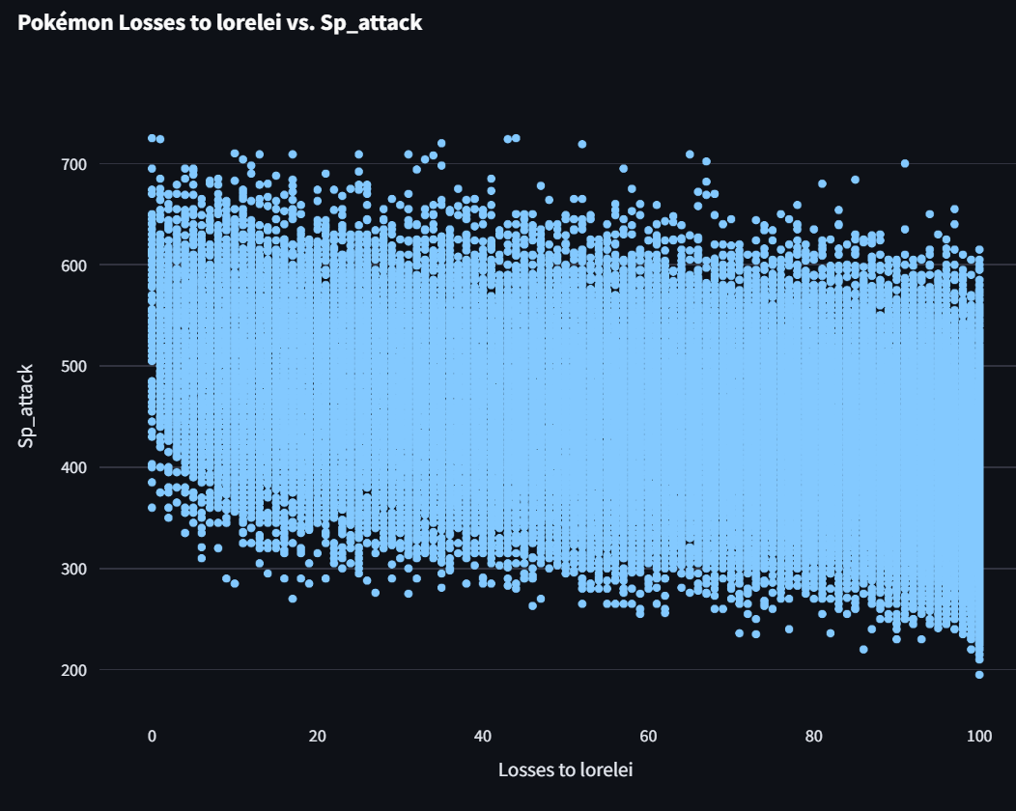
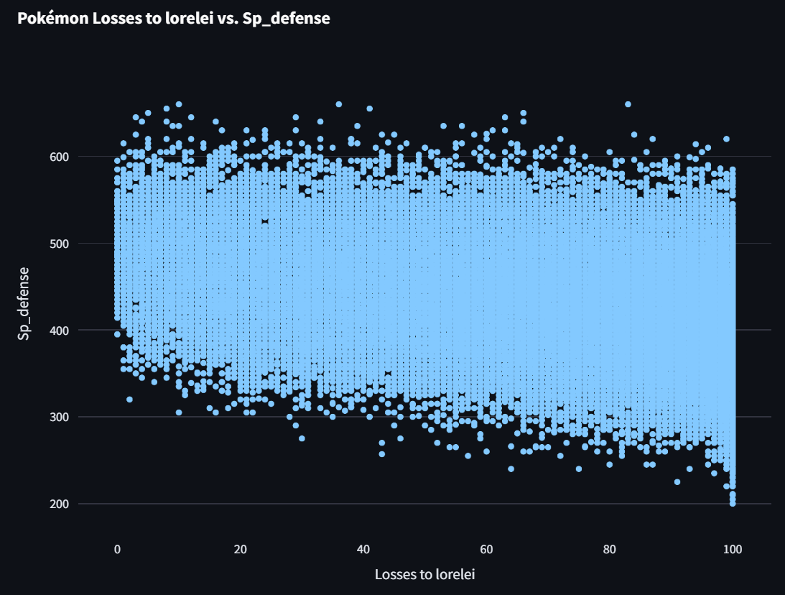
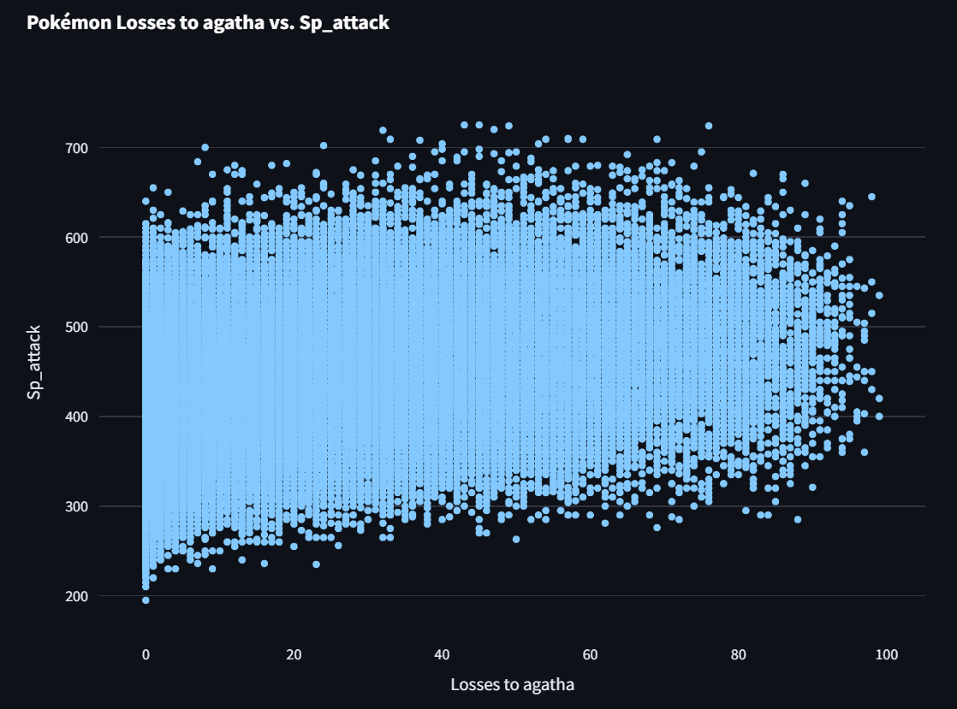
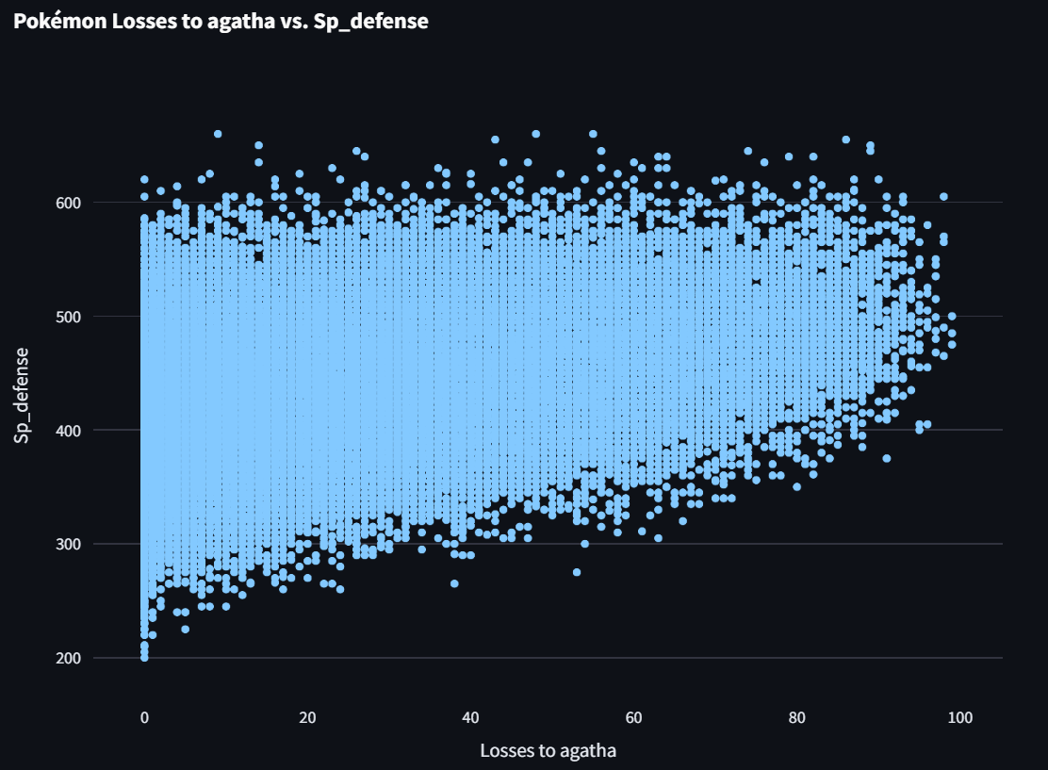
Results
Hamming
Background
Questions
Streamlit
Experiments
Assumptions
API

Slide 27
What might be on the Next Episode
Add move limits (PP)
Allow item usage
Allow for move selection input
Compare available moves for each Pokémon
Do moves affect outcome more than stats?
Train an AI for each Pokémon to handle the move inputs
Results
Hamming
Background
Questions
Further Research
Experiments
Assumptions
API

Slide 28
Streamlit
Hamming
Questions
Results
Background
Experiments
Assumptions
API

Slide 30
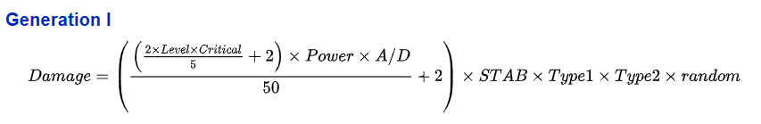
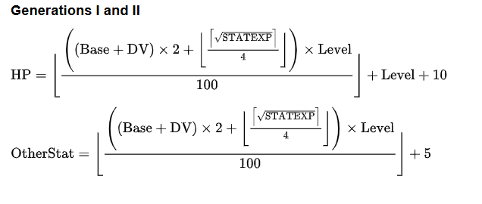
Appendix Slides
For leveling up the Pokémon, we set DV and STATEXP t = 0. These are values dependent on the Pokémon and how many prior battles it has undergone.

Slide 31
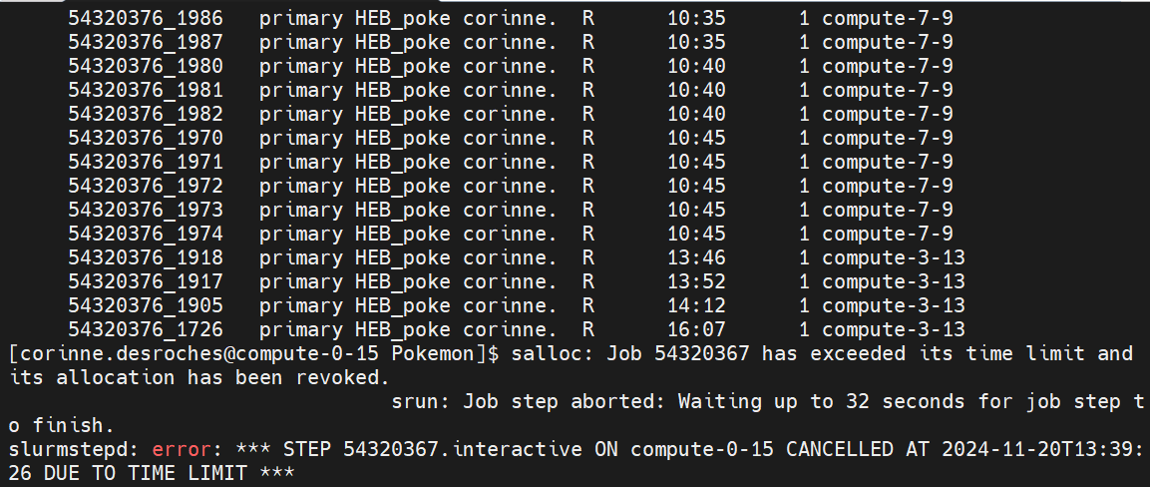
Appendix Slides
Hard limits discovered in nearly every system
CSVs have a limit of 1,048,576 rows
Hamming/SLURM can’t understand an array index larger than 99,999

